Slide 1
Deep Learning
Introduction to KERAS 2

Slide 2
Three API Styles
The Sequential Model
Dead simple
Only for single-input, single-output, sequential layer stacks
Good for 70+% of use cases
The functional API
Like playing with Lego bricks
Multi-input, multi-output, arbitrary static graph topologies
Good for 95% of use cases
Model subclassing
Maximum flexibility
Larger potential error surface

Slide 3
The Functional API
from tensorflow.keras.models import Model
from tensorflow.keras.layers import Dense, Input
inputs = Input(shape=(10,))
x = Dense(64, activation=‘relu’)(inputs)
x = Dense(64, activation=‘relu’)(x)
output = Dense(10, activation=‘softmax’)(x)
Model = Model(inputs, output)
Model.compile(optimizer=‘rmsprop’,
loss=‘categorical_crossentropy’,
metrics=[‘accuracy’])
model.fit(x, y, epochs=10, batch_size=32)

Slide 4
Defining the Model
from tensorflow.keras import models
from tensorflow.keras import layers
model = models.Sequential()
model.add(layers.Dense(32, activation='relu', input_shape=(784,)))
model.add(layers.Dense(10, activation='softmax'))
The same model defined using the functional API:
input_tensor = layers.Input(shape=(784,))
x = layers.Dense(32, activation='relu')(input_tensor)
output_tensor = layers.Dense(10, activation='softmax')(x)
model = models.Model(inputs=input_tensor, outputs=output_tensor)

Slide 5
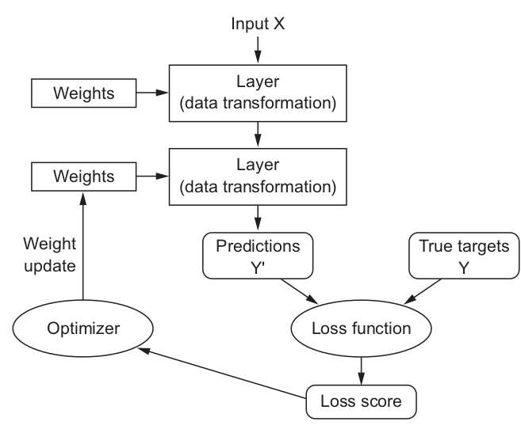
Alrighty, let’s put it together

Slide 6
Regularization
Adding weight regularization
l2(0.001) means every coefficient in the weight matrix of the layer will add 0.001 * weight_coefficient_value to the total loss of the network.
Note that because this penalty is only added at training time, the loss for this network will be much higher at training than at test time.
from tensorflow.keras import regularizers
model = models.Sequential()
model.add(layers.Dense(16, kernel_regularizer=regularizers.l2(0.001),
activation='relu', input_shape=(10000,)))
model.add(layers.Dense(1, activation='sigmoid'))

Slide 7
Dropout
model = models.Sequential()
model.add(layers.Dense(16, activation='relu', input_shape=(10000,)))
model.add(layers.Dropout(0.5))
model.add(layers.Dense(16, activation='relu'))
model.add(layers.Dropout(0.5))
model.add(layers.Dense(1, activation='sigmoid'))

Slide 8
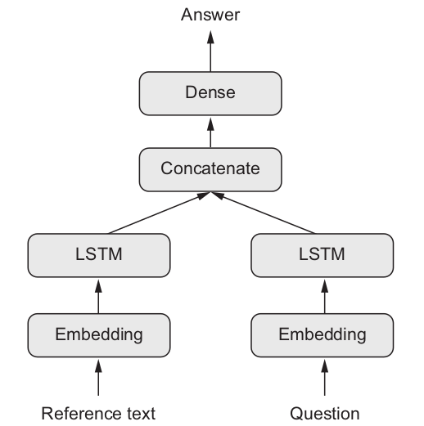
Multi Input Models

Slide 9
Multi Input Model using the functional API
text_input = Input(shape=(None,), dtype='int32', name='text')
embedded_text = layers.Embedding(64, text_vocabulary_size)(text_input)
encoded_text = layers.LSTM(32)(embedded_text)
question_input = Input(shape=(None,), dtype='int32’, name='question')
embedded_question = layers.Embedding(32, question_vocabulary_size)(question_input)
encoded_question = layers.LSTM(16)(embedded_question)
concatenated = layers.concatenate([encoded_text, encoded_question], axis=-1)
answer = layers.Dense(answer_vocabulary_size, activation='softmax')(concatenated)
model = Model([text_input, question_input], answer)
model.compile(optimizer='rmsprop’, loss='categorical_crossentropy’, metrics=['acc'])

Slide 10
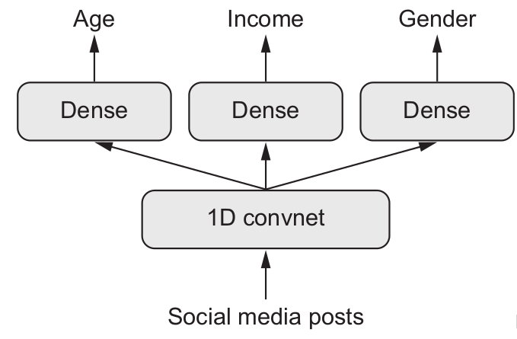
Multi-Output Models

Slide 11
Multi-Output Models
posts_input = Input(shape=(None,), dtype='int32', name='posts')
embedded_posts = layers.Embedding(256, vocabulary_size)(posts_input)
x = layers.Conv1D(128, 5, activation='relu')(embedded_posts)
x = layers.MaxPooling1D(5)(x)
... # Construct the network how you like it
x = layers.Dense(128, activation='relu')(x)
age_prediction = layers.Dense(1, name='age')(x)
income_prediction = layers.Dense(num_income_groups, activation='softmax’, name='income')(x)
gender_prediction = layers.Dense(1, activation='sigmoid', name='gender')(x)
model = Model(posts_input,[age_prediction, income_prediction, gender_prediction])

Slide 12
Multi-Output Models
model.compile(optimizer='rmsprop’,
loss=['mse', 'categorical_crossentropy', 'binary_crossentropy'])
model.compile(optimizer='rmsprop',
loss={'age': 'mse',
'income': 'categorical_crossentropy',
'gender': 'binary_crossentropy'})
Fitting, etc, of the model remains the same as with a normal network.

Slide 13
Callbacks
When training a model, there are many things you cannot predict
Sometimes it would be helpful to intervene when something goes wrong
Keras provides callbacks:
Model checkpointing: Saving the current weights of the model at different points during training.
Early stopping: Interrupting training when the validation loss is no longer improving (and of course, saving the best model obtained during training).
Dynamically adjusting the value of certain parameters during training: Such as the learning rate of the optimizer.
Logging training and validation metrics during training, or visualizing the representations learned by the model as they’re updated: The Keras progress bar is a callback!

Slide 14
Implementing your own Callback
Callbacks are implemented by sub-classing the class keras.callbacks.Callback.
You can implement the following functions:
on_epoch_begin
on_epoch_end
on_batch_begin
on_batch_end
on_train_begin
on_train_end

Slide 15
TensorBoard / Weights and Biases
Callbacks allow you to send run information to services that help you track and visualize runs.
TensorBoard runs locally on a logs folder
Highly modular, but base features are lacking
Weights and Biases runs in the cloud by sending the information to their servers. Only need to log onto their servers once on your local machine
No/Low modularity, but base feautures are rich and easy to setup

Slide 16
TensorBoard
!pip install tensorboard
tensorboard_callback = TensorBoard(log_dir=/path/to/logs/’, update_freq='batch')
model.fit(x=train_data, y=val_data, epochs=10, callbacks=[tensorboard_callback])
Terminal or CMD:
C:\Users\Name\Desktop>tensorboard --logdir /path/to/logs/
>> ‘TensorBoard 2.4.0 at http://localhost:6006/ (Press CTRL+C to quit)’

Slide 17
Weights and Biases
!pip install wandb
import wandb
wandb.init(project=‘project name)
from wandb.keras import model.fit(x=train_data, y=val_data, epochs=10, callbacks=[WandbCallback()])

Slide 18
Early Stopping
import tensorflow as tf
callbacks_list = [
tf.keras.callbacks.EarlyStopping(
monitor='acc',
patience=1),
tf.keras.callbacks.ModelCheckpoint(
filepath='my_model.h5',
monitor='val_loss',
save_best_only=True)]
model.compile(optimizer='rmsprop', loss='binary_crossentropy', metrics=['acc'])
model.fit(x, y, epochs=10, batch_size=32, callbacks=callbacks_list, validation_data=(x_val, y_val))

Slide 19
Predictions
from tensorflow.keras.models import load_model
model = load_model('model.h5')
predictions = model.predict(test_data)
# Sigmoid (Boolean)
predictions = (predictions > 0.5).astype(int).reshape(test_labels.shape)
# Softmax (Multi class)
predictions = predictions.argmax(axis=-1)
wrong_data = test_data[test_labels != predictions]
wrong_preds = predictions[test_labels != predictions]

Slide 20
Data Generators
Data generators allows you to import, train, and discard batches of data from memory.
Provides the option for ‘on the fly’ data augmentation
Useful for large datasets, which cannot be stored in memory

Slide 21
Data Generators
tf.keras.preprocessing.image.ImageDataGenerator(
featurewise_center=False,
samplewise_center=False,
featurewise_std_normalization=False,
samplewise_std_normalization=False,
zca_whitening=False,
zca_epsilon=1e-06,
rotation_range=0,
width_shift_range=0.0,
height_shift_range=0.0,
brightness_range=None,
shear_range=0.0,
zoom_range=0.0,
channel_shift_range=0.0,
fill_mode="nearest",
cval=0.0,
horizontal_flip=False,
vertical_flip=False,
rescale=None,
preprocessing_function=None,
data_format=None,
validation_split=0.0,
dtype=None)
https://keras.io/api/preprocessing/image/

Slide 22
Data Generators
train_datagen = ImageDataGenerator(
rescale=1./255, shear_range=0.2, zoom_range=0.2, horizontal_flip=True)
test_datagen = ImageDataGenerator(rescale=1./255)
train_generator = train_datagen.flow_from_directory(
'data/train’, target_size=(150, 150), batch_size=32, class_mode='binary’)
validation_generator = test_datagen.flow_from_directory(
'data/validation’, target_size=(150, 150), batch_size=32, class_mode='binary’)
model.fit(train_generator, steps_per_epoch=2000, epochs=50, v alidation_data=validation_generator, validation_steps=800)
https://keras.io/api/preprocessing/image/

Slide 23
Deep Learning Workflow
Defining the problem and assembling a dataset
Choosing a measure of success
Decide on the evaluation protocol
Preparing your data
Define a model better than base-line
Scaling up: Make the model overfit
Regularizing your model and tuning your hyperparameters
Finalize your final model

Slide 24
Deep Learning Workflow
Defining the problem and assembling a dataset
What will your input data be?
What type of problem are you facing? Classification? Regression? …
Choosing a measure of success
Decide on the evaluation protocol
Preparing your data
Define a model better than base-line
Scaling up: Make the model overfit
Regularizing your model and tuning your hyperparameters
Finalize your final model

Slide 25
Deep Learning Workflow
Defining the problem and assembling a dataset
Choosing a measure of success
How do you measure if the model is successful
Not to be confused with the loss function which is often only a surrogate for what you actually want achieve
Decide on the evaluation protocol
Preparing your data
Define a model better than base-line
Scaling up: Make the model overfit
Regularizing your model and tuning your hyperparameters
Finalize your final model

Slide 26
Deep Learning Workflow
Defining the problem and assembling a dataset
Choosing a measure of success
Decide on the evaluation protocol
hold-out validation
Cross-validation
Preparing your data
Define a model better than base-line
Scaling up: Make the model overfit
Regularizing your model and tuning your hyperparameters
Finalize your final model

Slide 27
Deep Learning Workflow
Defining the problem and assembling a dataset
Choosing a measure of success
Decide on the evaluation protocol
Preparing your data
Clean data
Normalize data
Define a model better than base-line
Scaling up: Make the model overfit
Regularizing your model and tuning your hyperparameters
Finalize your final model

Slide 28
Deep Learning Workflow
Defining the problem and assembling a dataset
Choosing a measure of success
Decide on the evaluation protocol
Preparing your data
Define a model better than base-line
Last-layer activation
Loss function
Optimization Algorithm
Scaling up: Make the model overfit
Regularizing your model and tuning your hyperparameters
Finalize your final model

Slide 29
Deep Learning Workflow
Defining the problem and assembling a dataset
Choosing a measure of success
Decide on the evaluation protocol
Preparing your data
Define a model better than base-line
Scaling up: Make the model overfit
Add layers.
Make the layers bigger.
Train for more epochs.
Regularizing your model and tuning your hyperparameters
Finalize your final model

Slide 30
Deep Learning Workflow
Defining the problem and assembling a dataset
Choosing a measure of success
Decide on the evaluation protocol
Preparing your data
Define a model better than base-line
Scaling up: Make the model overfit
Regularizing your model and tuning your hyperparameters
This will take the most time
Add dropout.
Try different architectures: add or remove layers.
Add L1 and/or L2 regularization
Finalize your final model

Slide 31
Deep Learning Workflow
Defining the problem and assembling a dataset
Choosing a measure of success
Decide on the evaluation protocol
Preparing your data
Define a model better than base-line
Scaling up: Make the model overfit
Regularizing your model and tuning your hyperparameters
Finalize your final model
Save and distribute the model

